Slide 1
R Data Structures
R has six types of basic data structures .
  Vectors.
  Matrices
  Arrays
  Data Frames
  Factors
  Lists

Slide 2
Vectors.
Vectors are one-dimensional arrays that can hold numeric data, character data, or logical data. The combine function c() is used to form the vector.
a <- c(1, 2, 5, 3, 6, -2, 4)
b <- c("one", "two", "three")
c <- c(TRUE, TRUE, TRUE, FALSE, TRUE, FALSE)

Slide 3
Vectors
name <- “hello world”
Here hello world is stored as a single character string. How can we store both the first and last name separately in a single object?
The function c() concatenates or combines single R objects into a vector of R objects.
Name <- c(“hello”, “world”)
now what will be the length of the name variable?

Slide 4
Mathematical operations Using Vector
X <- c(2,4,6,8)
X + 2 # add 2 to each element of the vector x
Output : [1] 4 6 8 10
x * 3 # multiple each element of x by 3
Output: [1] 6 12 18 24
x+ c(3,4,5,6) # add elements together in matching positions
Output : [1] 5 8 11 14
Notes:
Some examples of applications (potential or actual) are:
– a supermarket chain mines its customer transactions data to optimise targeting
of high value customers
– a credit card company can use its data warehouse of customer transactions
for fraud detection
– predicting the probability of default for consumer loan applications by improving
the ability to predict bad loans
– predicting the probability that a cancer patient will respond to chemotherapy,
thus reducing health-care costs without affecting quality of care.

Slide 5
Sort a Vector
To short in a vector alphabetically or numerically , use the sort() function.
Example:
X <- c(20,10,40,15)
sort(X)
X<-c( “B”, “A”, “D”)
sort(X)

Slide 6
Access Vector
You can access the vector items by referring to its index number inside brackets[].the first item has index 1 and second item has index 2 and so on.
X <- c(20,10,40,15)
X[1]
Output : [1] 20

Slide 7
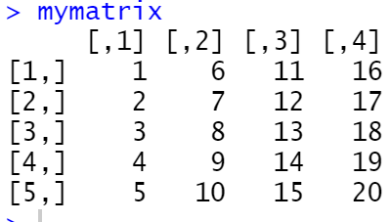
Matrices
A matrix is a two-dimensional array where each element has the same mode (numeric , character, or logical). Matrices are created with the matrix function . The general format is
mymatrix<-matrix(vector,nrow = no_of_rows,ncol = no_of_columns,byrow = logical_value ,dimnames = list(char_vector_rownames,char_vector_columnsnames))
Example: Creating matrices…
mymatrix<-matrix(1:20, nrow = 5,ncol = 4)

Slide 8
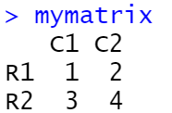
Matrix filled by rows
cells <- c(1:4)
rnames <- c("R1", "R2")
cnames <- c("C1", "C2")
mymatrix <- matrix(cells, nrow=2, ncol=2, byrow=TRUE, dimnames=list(rnames, cnames))
>mymatrix

Slide 9
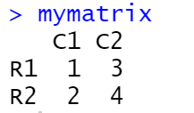
Matrix filled by columns
cells <- c(1:4)
rnames <- c("R1", "R2")
cnames <- c("C1", "C2")
mymatrix <- matrix(cells, nrow=2, ncol=2, byrow=FALSE, dimnames=list(rnames, cnames))
>mymatrix

Slide 10
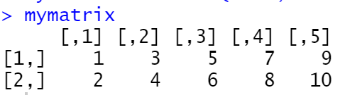
You can identify rows, columns, or elements of a matrix by using subscripts and brackets. X[i,] refers to the ith row of matrix X, X[,j] refers to jth column, and X[i, j] refers to the ijth element, respectively. The subscripts i and j can be numeric vectors in order to select multiple rows or columns, as shown in the following listing. mymatrix<- matrix(1:10, nrow=2,ncol=5)
>mymatrix[2,]
[1] 2 4 6 8 10
>mymatrix[2,]
[1] 2 4 6 8 10
>mymatrix[,2]
[1] 3 4
>mymatrix[1,3]
?
>mymatrix[1,c(2,3)]
?

Slide 11
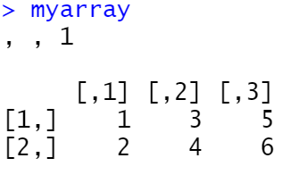
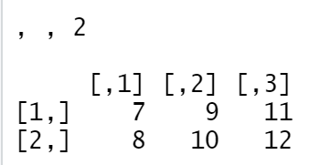
Arrays
Arrays are similar to matrices but can have more than two dimensions. They’re created with an array function of the following form:
myarray <- array(vector, dimensions, dimnames)
myarray<- array(1:24, c(2, 3, 2))
Myarray

Slide 12
Access Array Items
You can access the array elements by referring to the index position. You can use the [] brackets to access the desired elements from an array:
myarray[1,2,1]
Output: [1] 3

Slide 13
Data frames
A data frame is more general than a matrix in that different columns can contain different modes of data (numeric, character, etc.). It’s similar to the datasets you’d typically see in SAS, SPSS, and Stata. Data frames are the most common data structure you’ll deal with in R.
A data frame is created with the data.frame() function :
mydata <- data.frame(col1, col2, col3,…)

Slide 14
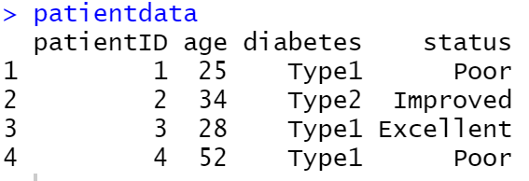
patientID <- c(1, 2, 3, 4)
age <- c(25, 34, 28, 52)
diabetes <- c("Type1", "Type2", "Type1", "Type1")
status <- c("Poor", "Improved", "Excellent", "Poor")
patientdata <- data.frame(patientID, age, diabetes, status)
patientdata

Slide 15
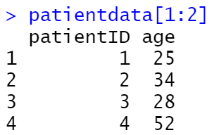
Specifying elements of a data frame
There are several ways to identify the elements of a data frame. You can use the subscript notation you used before (for example, with matrices) or you can specify column names.

Slide 16
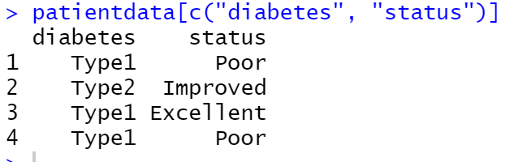
patientdata[c("diabetes", "status")]

Slide 17
Factors
Factors are the data objects which are used to categorize the data and store it as levels.To create a factor , use the factor() function and add a vector as argument.
students_cgpa<- factor(c("A","A+","B","C","B","C"))
students_cgpa
[1] A A+ B C B C
Levels: A A+ B C

Slide 18
List
Lists are the most complex of the R data types. Basically, a list is an ordered collection of objects (components). A list allows you to gather a variety of (possibly unrelated) objects under one name. For example, a list may contain a combination of vectors, matrices, data frames, and even other lists. You create a list using the list() function :
mylist <- list(object1, object2, …)

Slide 19
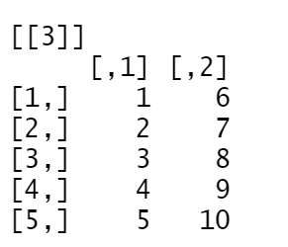
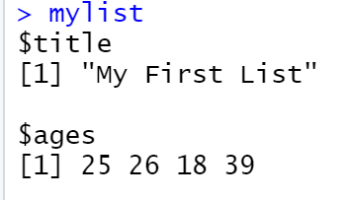

g <- "My First List"
h <- c(25, 26, 18, 39)
j <- matrix(1:10, nrow=5)
k <- c("one", "two", "three")
mylist <- list(title=g, ages=h, j, k)

Slide 20
Access List
  Example: mylist[[2]]
  Output:
  [1] 25 26 18 39

Slide 21
Add List Items
  To add an item to the end of the list use the append() function
  Item <- list(“mango”, “apple”)
  append(item,”orange”)
  To add an item to the right of a specified index add “after=index number” in the append function.
  Item <- list(“mango”, “apple”)
  append(item,”orange”,after=1)

Slide 22
Remove List Items
  If we want to remove mango from the list…..
  Item <- list(“mango”, “apple”)
  Newitem<- item[-1]

